Slide 1
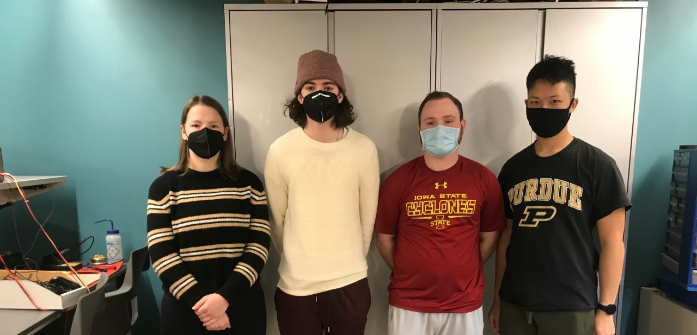


ECE477 MIDTERM DESIGN REVIEW: TEAM 2

Slide 2
OUTLINE
Project Overview
Block Diagram
Major Components
Packaging Design
Electrical Schematic
PCB Layout
Prototyping Progress
Software Development Status
Project Timeline
Questions
Notes:
Brian

Slide 3
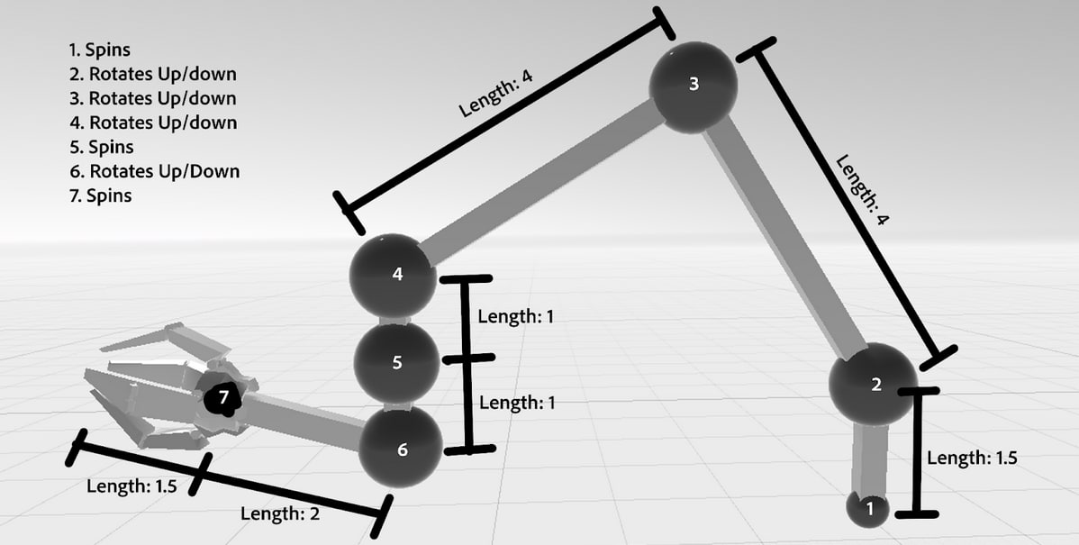
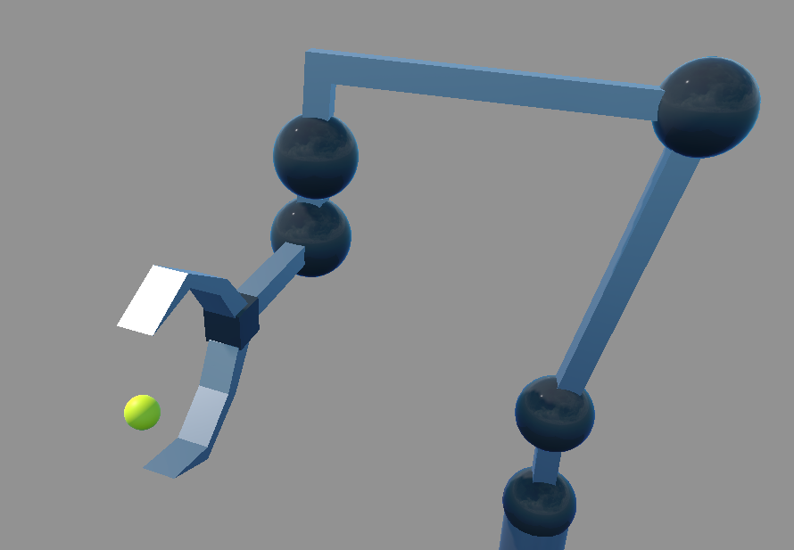
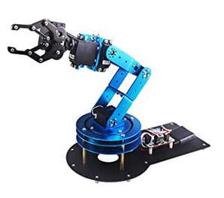
PROJECT OVERVIEW
VRm is a Virtual Reality project that allows a user to control a physical robot arm via a VR simulation.
The the VR user will control the movement of the robot arm by manipulating a target with the controller, and the simulated arm will try to reach that targets position and rotation.
Allows for greater control of the robot arm compared to similar projects
VRm will allow users to complete tasks naturally in an environment that is unsafe and unsuitable for direct human interaction.
Notes:
Brian

Slide 4
PSSCS
PSSC #1: An ability to transmit data between the raspberry pi and the microcontroller through a wired connection.
PSSC #2: An ability to control the servos to reach a position to +/- 5 degrees on the robot arm.
PSSC #3: An ability to indicate when the Raspberry-Pi loses connection with the server by activating a buzzer with PWM.
PSSC #4: An ability to transmit data from the server to a Raspberry Pi wireless with a latency of less than one second.
PSSC #5: An ability to compute motor angles in Unity and send that data to the server with a latency of less than a half of a second.
Notes:
Brian

Slide 5
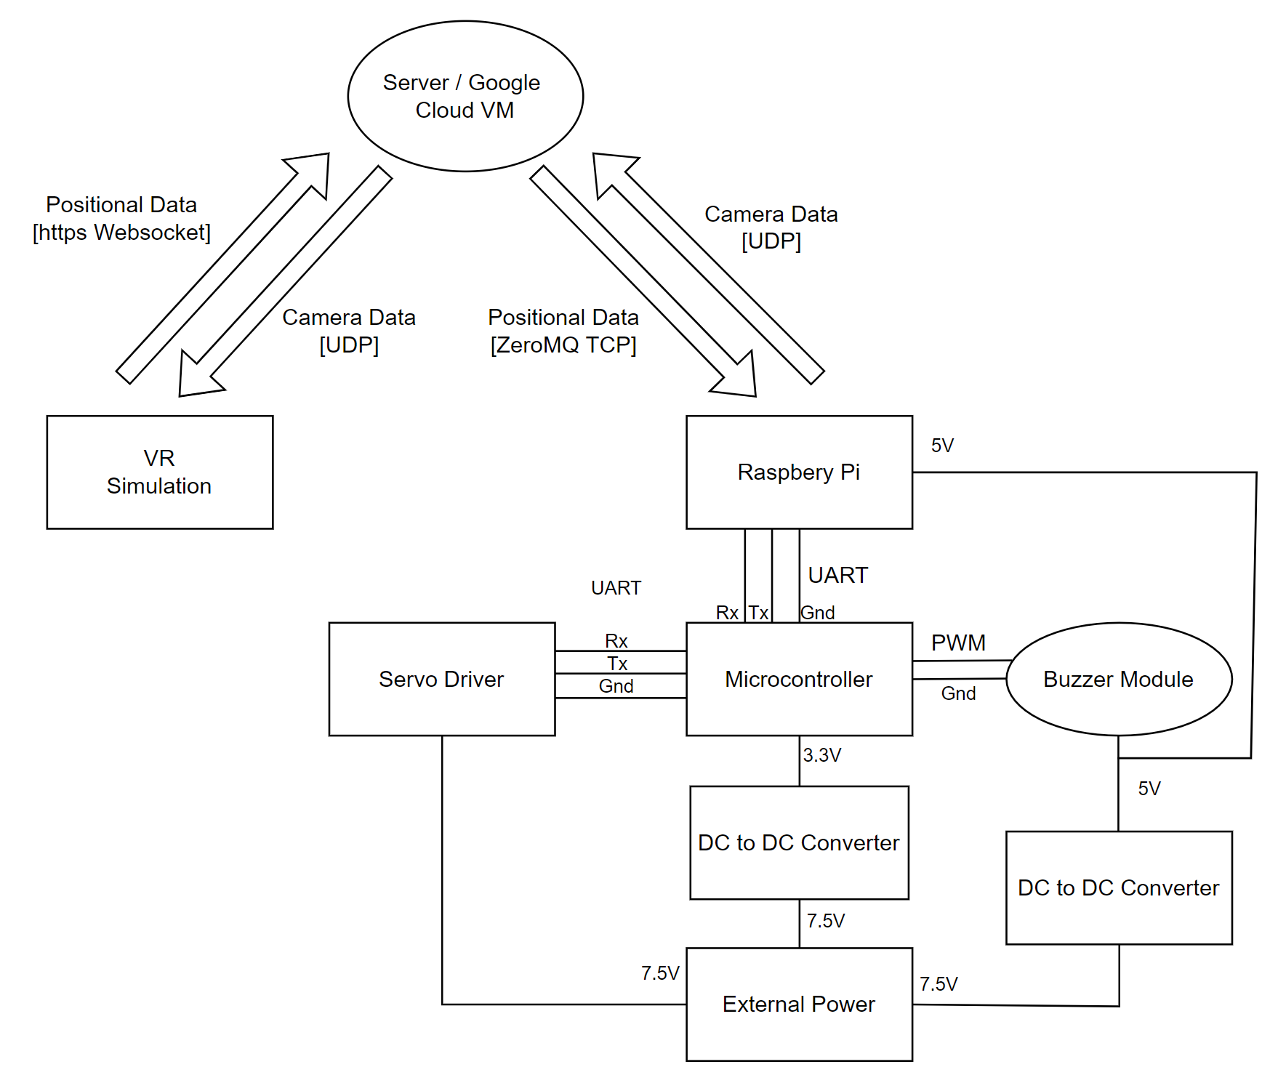
BLOCK DIAGRAM
Notes:
Brian/Matthew/Emma (for each component)

Slide 6
Component Selection: Microcontroller
 | STM32F091 | STM32F051
Operating Frequency | 48 MHz | 48 MHz
I/O pins | 52 | 39
RAM | 32KB | 8KB
UART module | 8 | 2
PWM | 6 | 6
Price | $2.42/10k units | $1.33/10k units
Selection Criteria:
Performance
UART (2) and PWM
Price
Considerations:
STM32F091
STM32F051
Final Selection:
STM32F091 (availability)

Slide 7
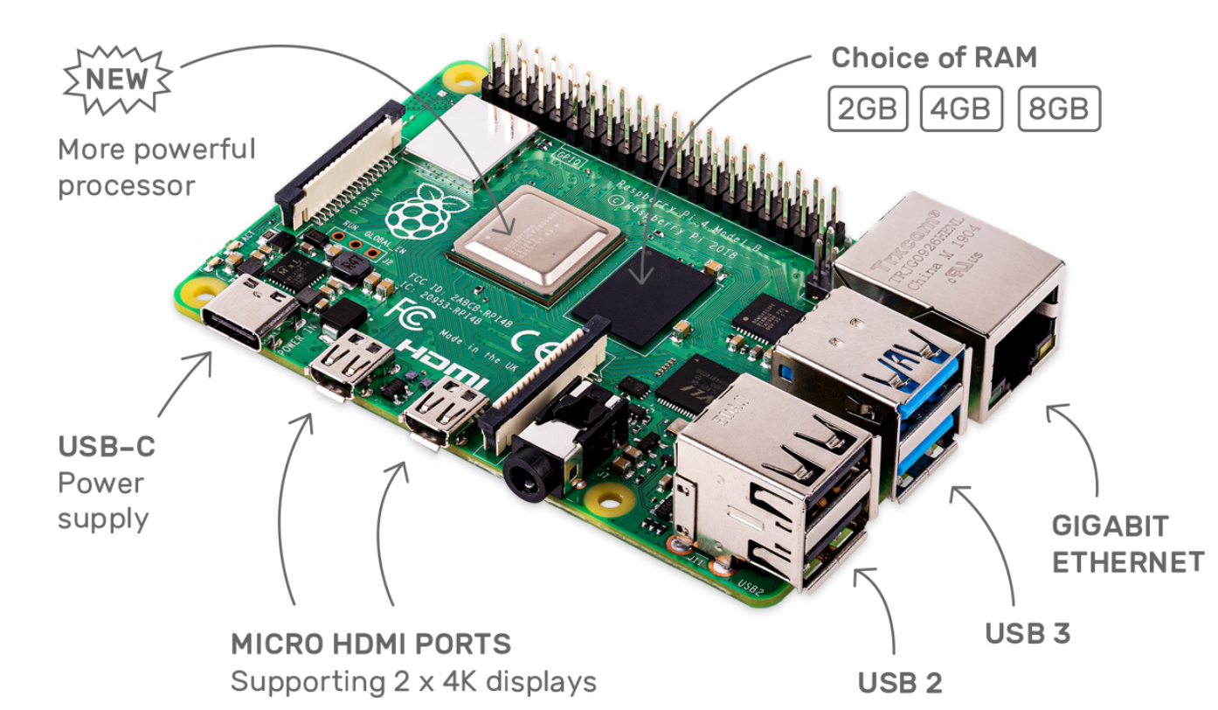
Component Selection: Connecting to Server
Selection Criteria:
Community Documentation
Easy to use libraries
Cheap
Considerations:
Raspberry-Pi
ESP32
Final Selection:
Raspberry-Pi

Slide 8
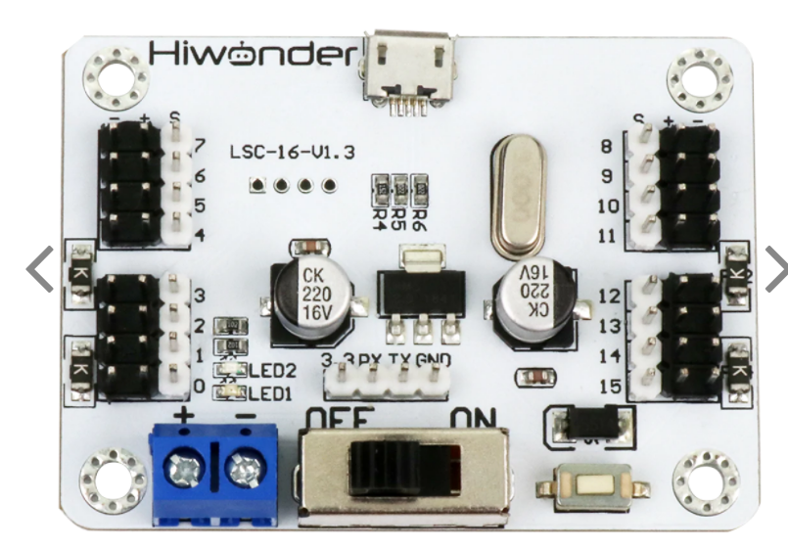
Component Selection: Servo Driver
Selection Criteria:
Control 7 servos simultaneously
Overcurrent protection
High Performance
Considerations:
LSC-16: 16-channel Servo Controller
PWM each individual servo
Final Selection:
16-channel Servo Controller (ease of use)

Slide 9
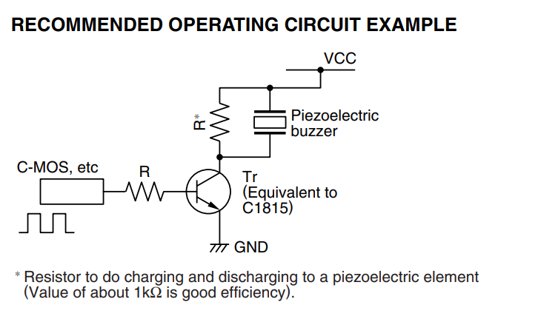
Component Selection: Buzzer Module
Selection Criteria:
Control Volume of buzzer
Audible pitch
Considerations:
PWM passive buzzer
Active buzzer
Final Selection:
PWM Passive Buzzer (change tone)
Notes:
An active buzzer generates the sound at a predefined frequency, so the tone cannot be adjusted.
A passive buzzer needs to be driven by a PWM signal. By changing the PWM frequency, you can change the tone.

Slide 10
MAJOR COMPONENTS
Microcontroller (STM32F091RCT6)
Operating Voltage 3.3V @ 120mA
52 I/O pins
Raspberry Pi
Operating Voltage 5V @ 2A
16-Channel Servo Driver
Operating Voltage 7.5V with over-current protection
Servos: ~3A stall current, 100mA no load current
Buzzer Module
Operating Voltage 5V @ 100mA
Wall Power supply
7.5 V, max 7A
DC to DC converters (2)
7.5V to 3.3V and 7.5V to 5V
Choose the major (electrical) components being utilized by your design. For each component, provide a brief description of what it is, relevant specifications, and what it will do. Examples of major components include the microcontroller, motors, wireless interfaces, power converters and regulators. Examples of relevant specifications include operating speed (uC), number of I/O (uC), stall current (motors), operating voltage, and expected current consumption
Notes:
Emma

Slide 11
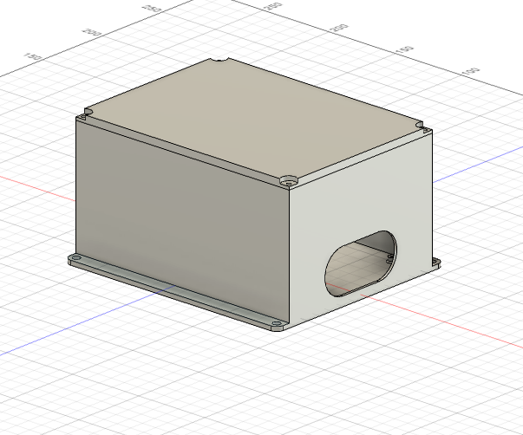
PACKAGING DESIGN
Include one or more images of your packaging design here. Include relevant dimensions and how you are planning to manufacture your product packaging.
Material | Tools Required | Weight | Cost | Dimensions
PC-Max (3D Print) | 3D Printer | 232g | $0 | 13 x 10 x 8 cm
Bolts/Spacers | Drill | 4g | $1 | N/A
Nuts | NA | 4g | $1 | N/A
Notes:
James

Slide 12
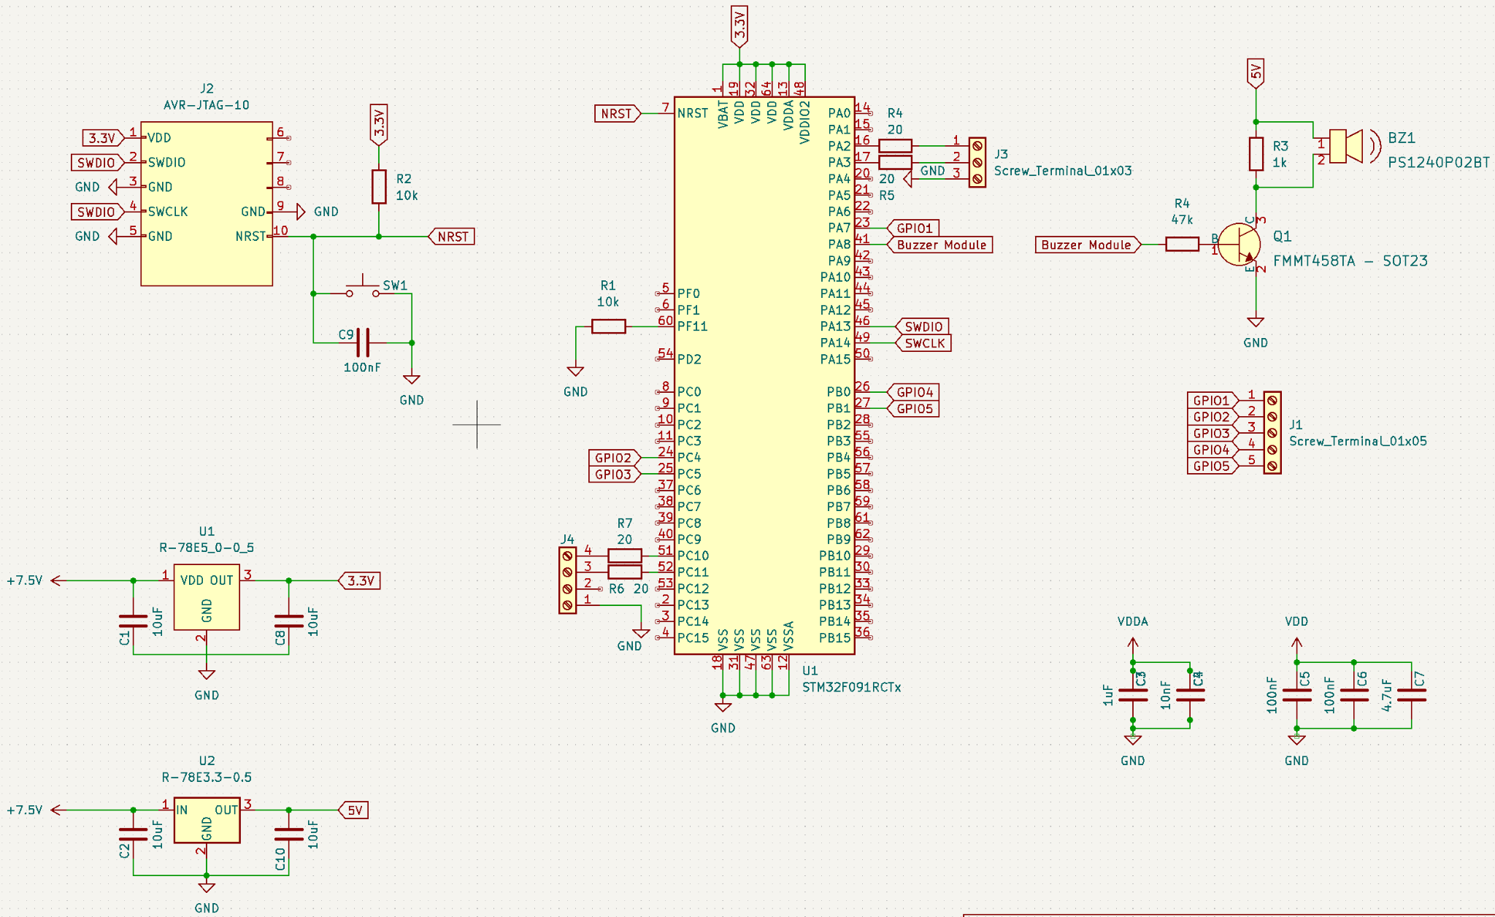
ELECTRICAL SCHEMATIC
Notes:
Emma - PA2 servo driver =------= PC10 raspberry pi
Programming header

Slide 13
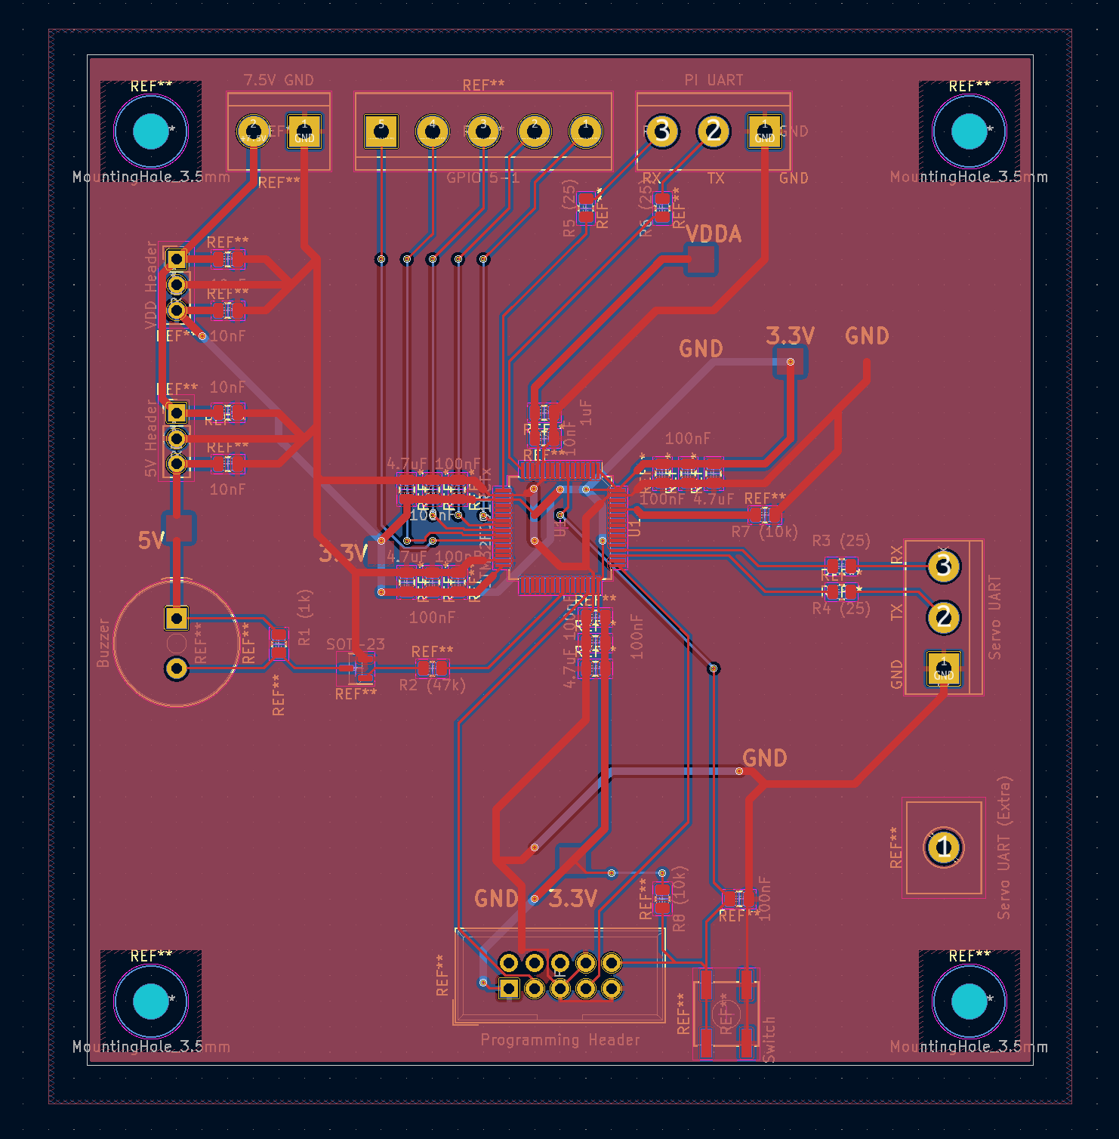
PCB LAYOUT
Overall Layout
Notes:
James

Slide 14
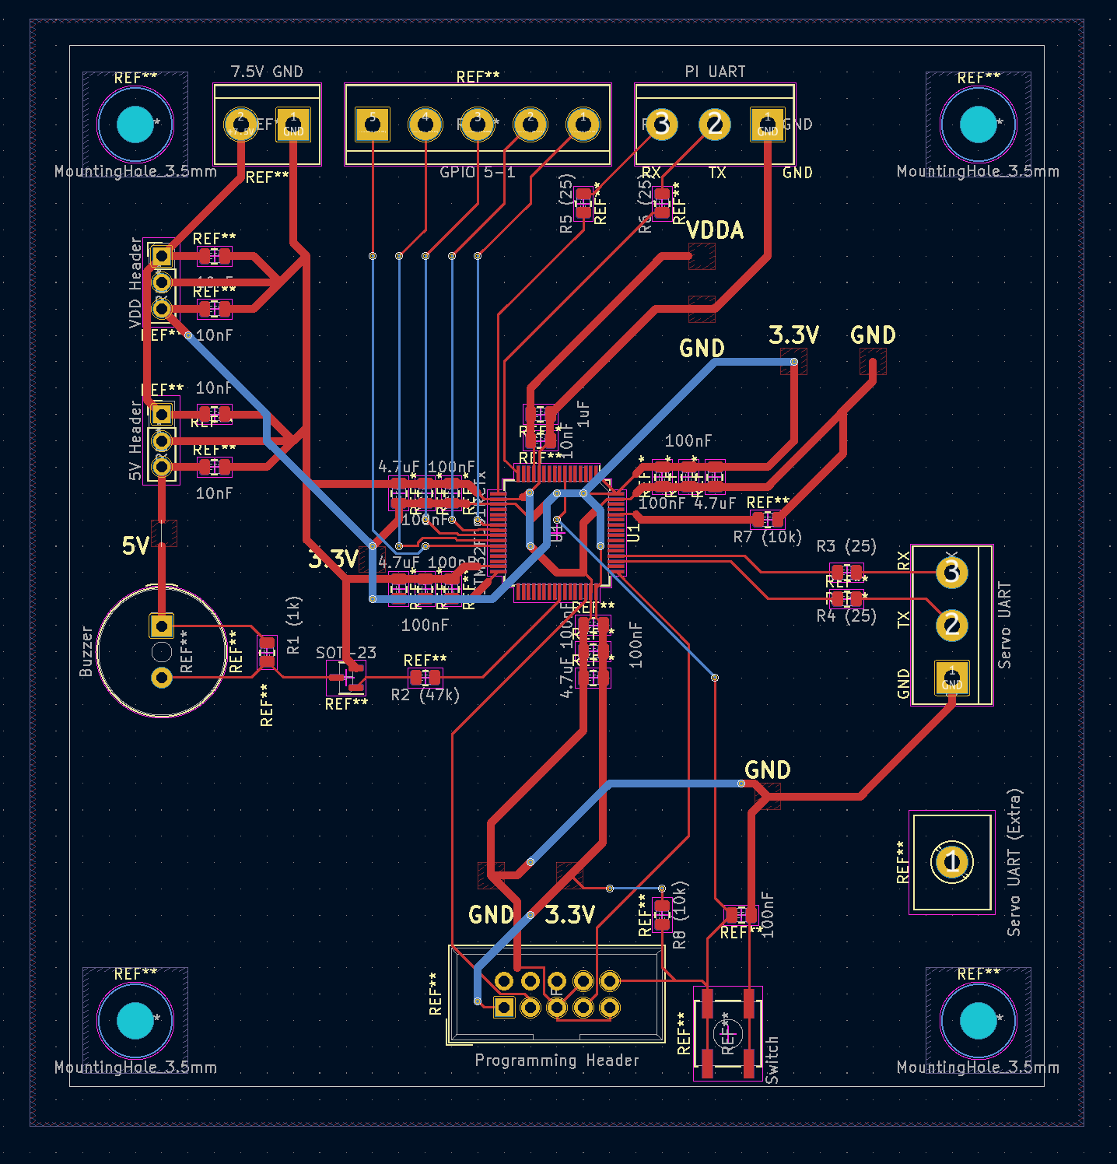
PCB LAYOUT
Overall Layout (No Fill)
Notes:
James

Slide 15
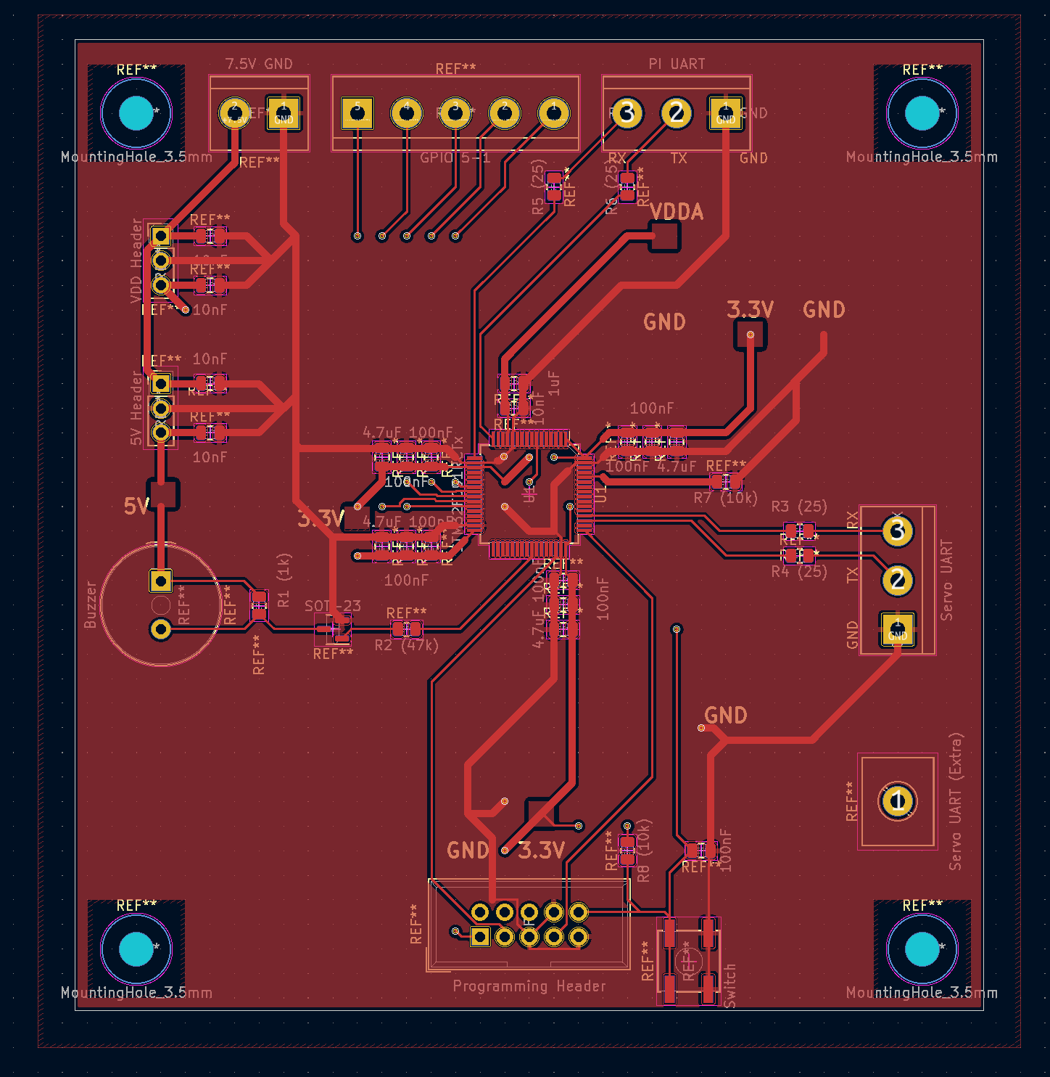
PCB LAYOUT
Top Layer (GND)
Notes:
James

Slide 16
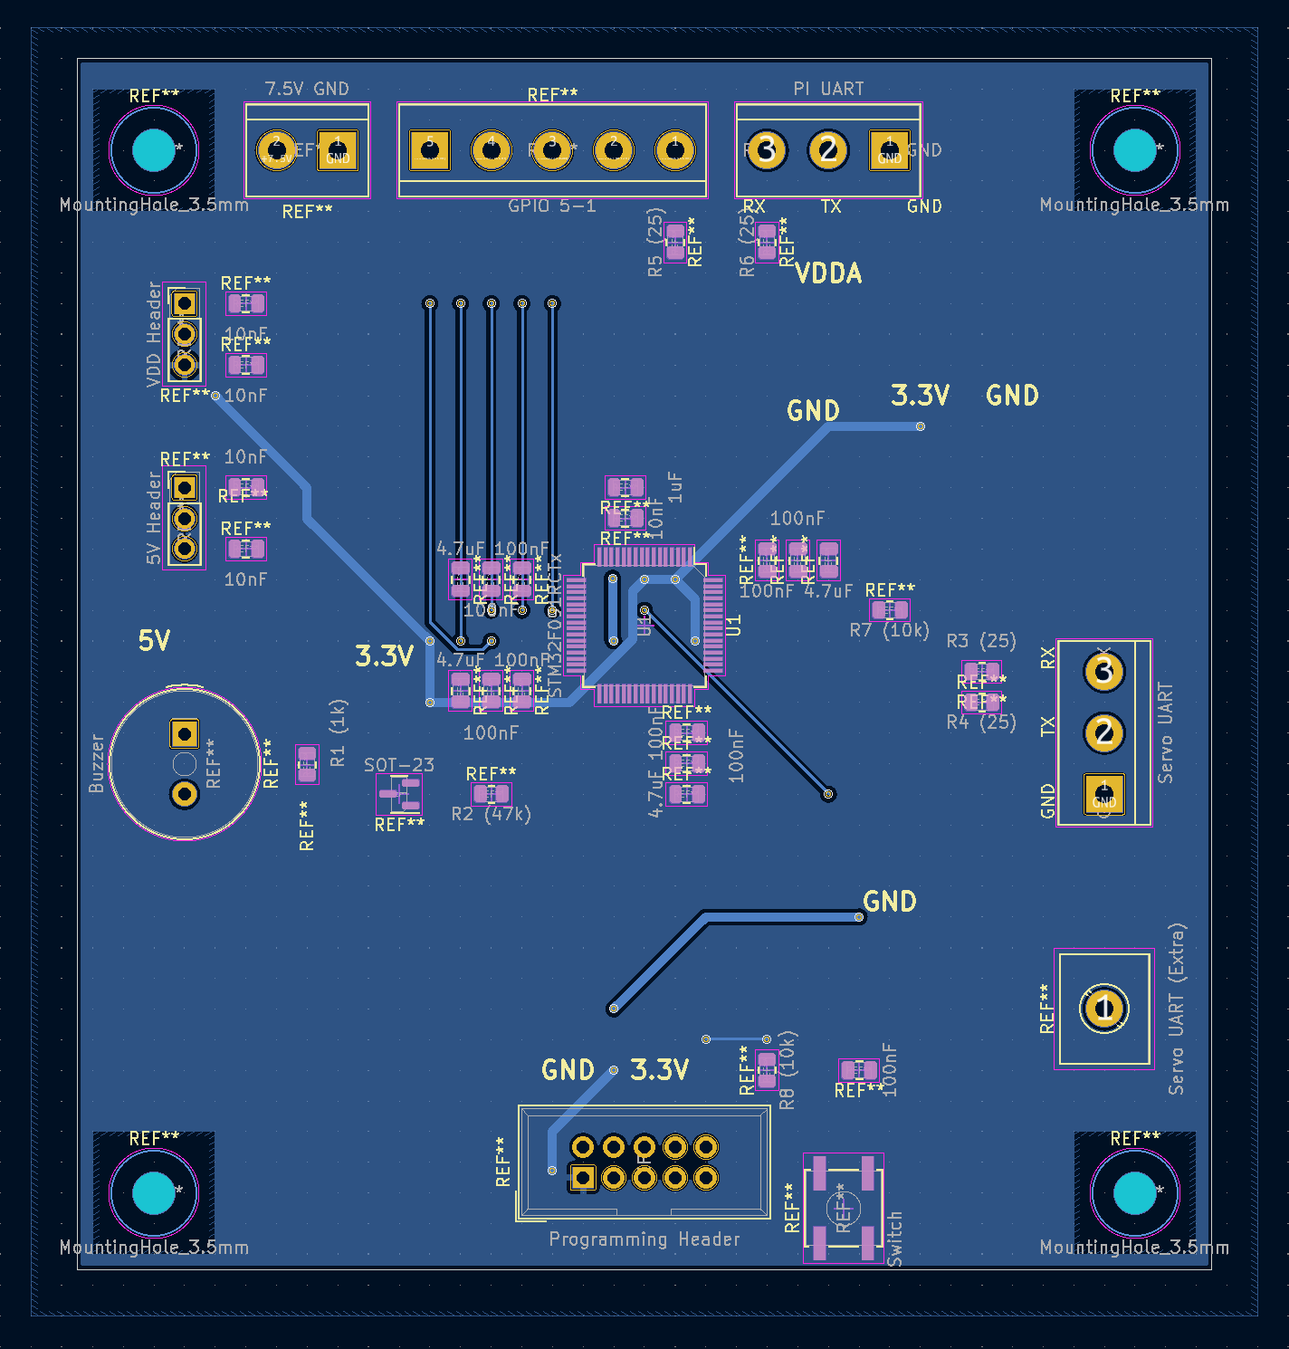
PCB LAYOUT
BottomLayer (VDD)
Notes:
James

Slide 17
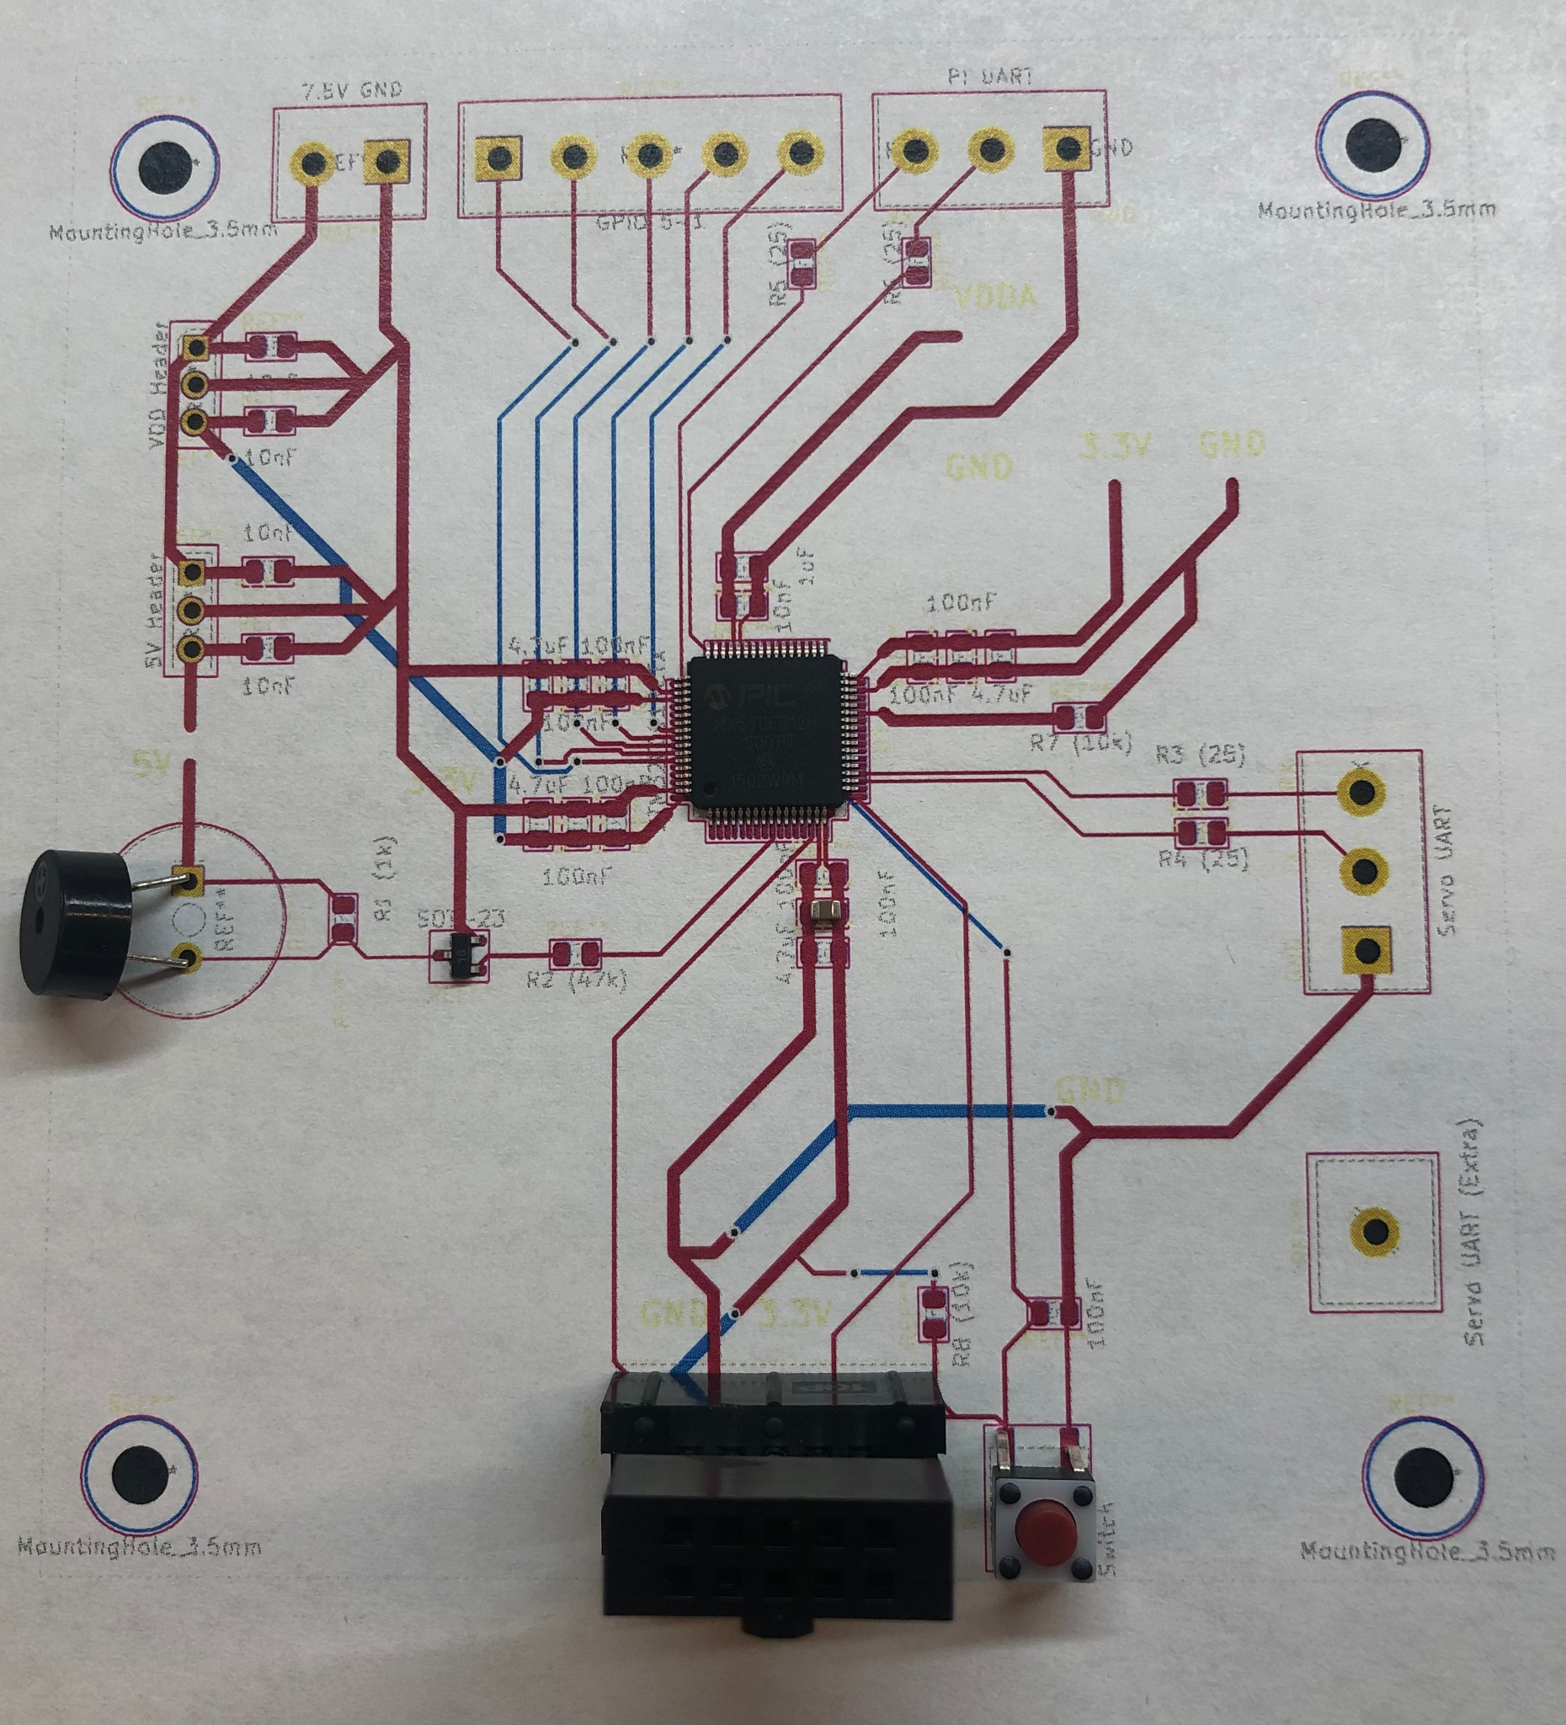
PCB LAYOUT
Footprints Verified
Notes:
James

Slide 18
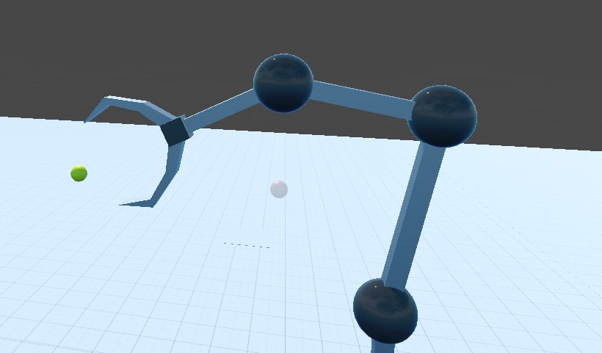
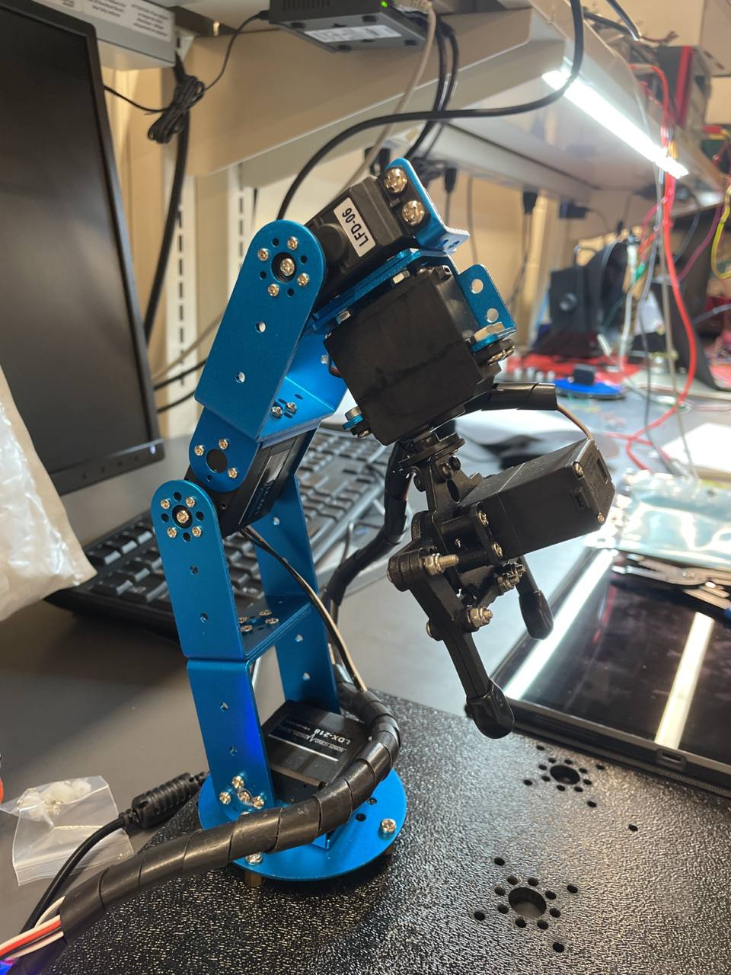
PROTOTYPING PROGRESS
Describe your team’s prototyping progress here. For each of your project’s major components, what has been tested? What is known to work? What still needs to be tested, and what still needs to be proven to work?
VR Simulation Controlling Robot Arm
Data is successfully transmitted between the simulation and robot arm
Next steps: Calibrate the simulation to match the real life servo limits
Notes:
Emma

Slide 19
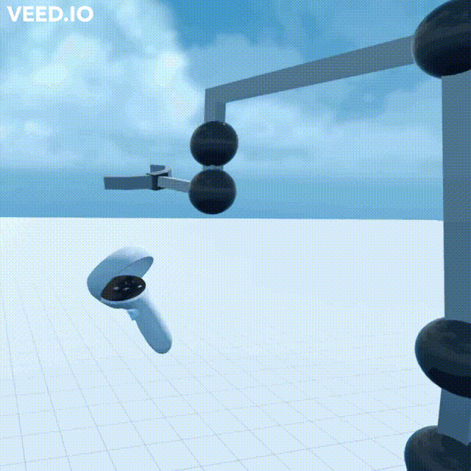
Video of Remote Control of Arm
7 joints (servo motors) allow for a more natural feeling control of the arm.
Notes:
Brian

Slide 20
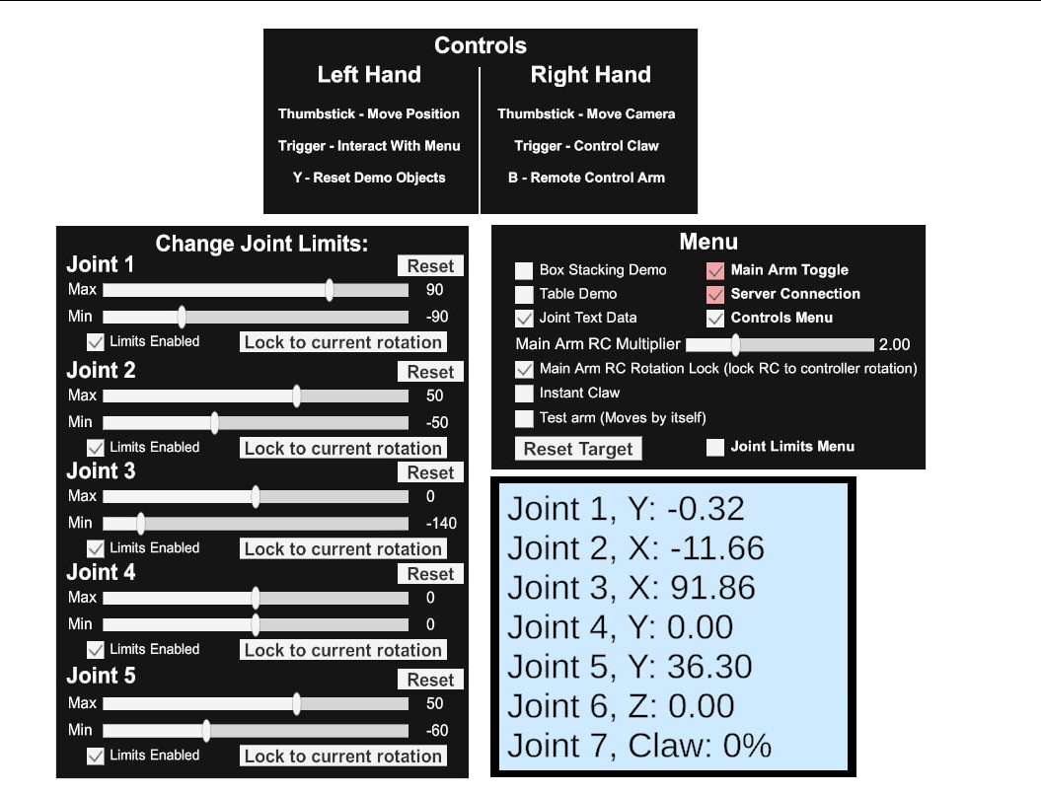
Menus Within The Simulation
Menu options allow for easier control from within the simulation
Controllers Guide
Main Controls
Joint settings
Rotational Data
Display
Notes:
Brian

Slide 21
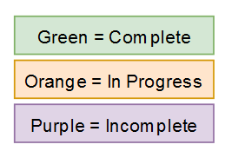
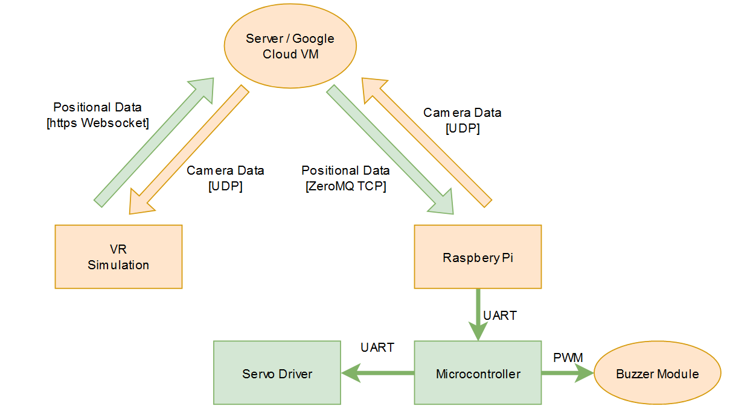
PROTOTYPING PROGRESS
General Overview of what is Completed
Notes:
Brian/Matthew/Emma (for each component)

Slide 22
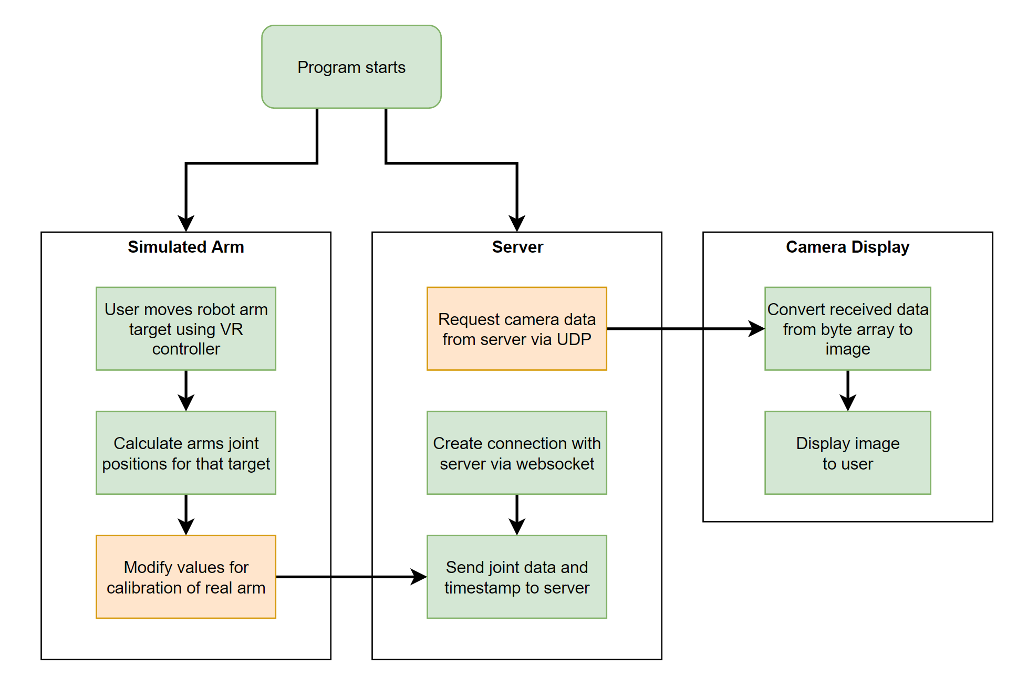
PROTOTYPING PROGRESS
VR Simulation Diagram
Notes:
Brian

Slide 23
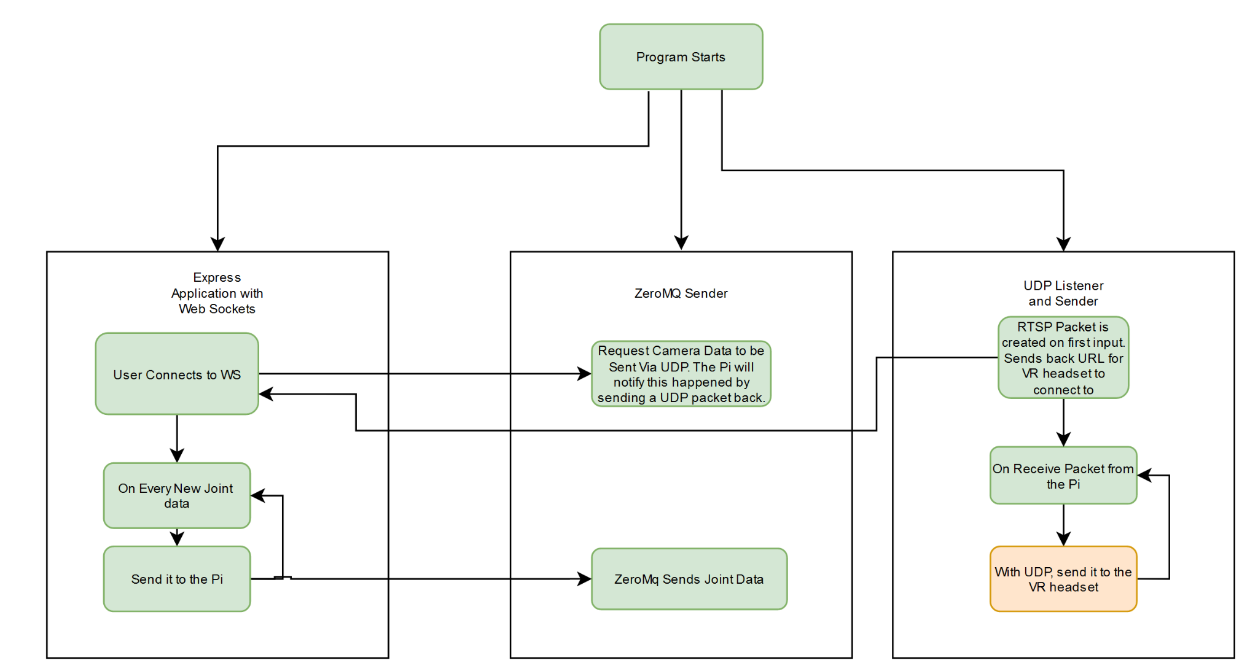
PROTOTYPING PROGRESS
Server Software Diagram
Notes:
Matthew Wen

Slide 24
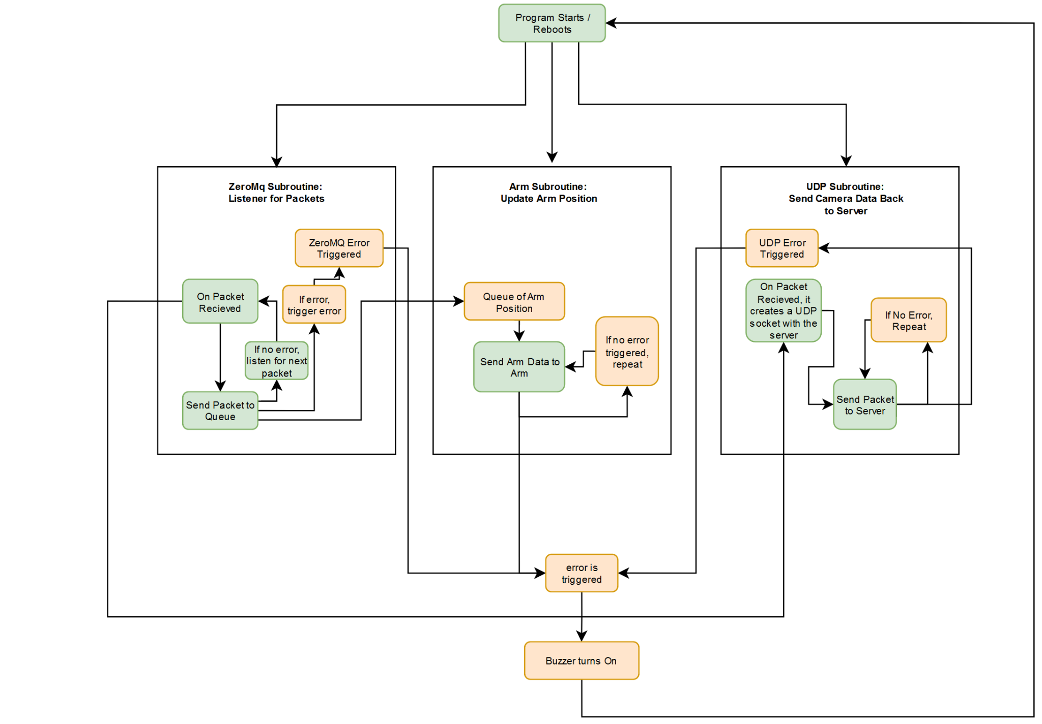
PROTOTYPING PROGRESS
Raspberry Pi Software Diagram
Notes:
Matthew Wen

Slide 25
SOFTWARE DEVELOPMENT STATUS
What Not Started, In Progress, In Testing, and Finished
Not Yet Started | In Progress | In Testing | Finished
Sending live stream via UDP | Connecting the camera to Raspberry Pi | Sending simple messages via UDP from VR, server, and Pi | Sending joint data from headset to server with a TCP Websocket with authentication
Connecting the buzzer and error handle when machine loses connection with server |  | Connecting incoming joint data to the robotic arm | Pub/Sub via ZeroMq joint data from server to Raspberry Pi.
Error Handling on the Pi. |  | Modifications of simulation to better match the real-life arm
Notes:
Brian/Matt
In this section, detail team progress with software development. List out the major modules for your team’s software. For each module, detail its status (Not yet started / In development / In testing / Completed)

Slide 26
PROJECT TIMELINE
Provide a timeline (or GANTT chart, etc.), starting from the current week until the end of the semester, detailing work to be undertaken in completing your team’s project.
James Donnelly + Emma Clary | Week 8 | Week 9 | Week 10 | Week 11 | Week 12 | Week 13 | Week 14 | Week 15 | Week 16
Add Degree of freedom to robot arm
Optimize code
Solder PCB
Debug PCB
Install power distribution system
Debug Entire System
Matthew Wen | Week 8 | Week 9 | Week 10 | Week 11 | Week 12 | Week 13 | Week 14 | Week 15 | Week 16
Camera live streaming from Pi to server
Error Handle Pi Disconnections to the Internet + Activating Buzzer
Add Home / Default Positions for Arm
Bug Fixes
Brian Latimer | Week 8 | Week 9 | Week 10 | Week 11 | Week 12 | Week 13 | Week 14 | Week 15 | Week 16
Tweak Simulation to match real arm
Add camera live stream on Unity
improve live stream functionality
Add/Improve features in simulation
Notes:
Everyone

Slide 27
3D PRINTING
Questions?

